Slide 1

team 31: Battleship
Sam Stinson, Courtney McNamara, Edward Chen, RYAN LICANDRO

Slide 2
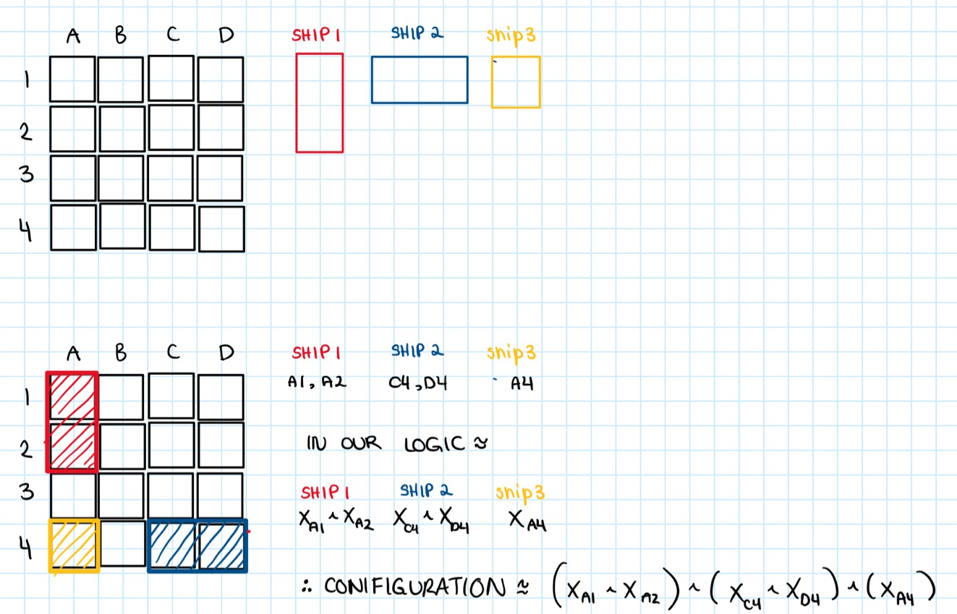
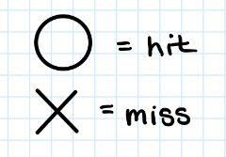
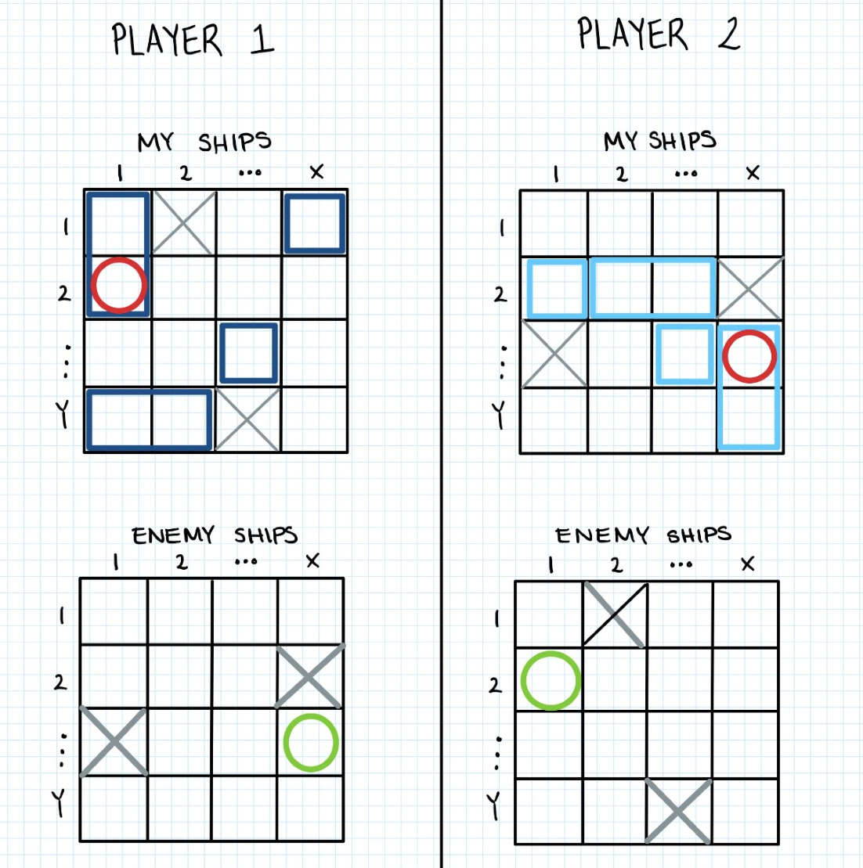
Summary
Battleships:
Ship 1 = (1 , 2)= 2 square
Ship 2 = (2, 1)= 2 square
Ship 3= (1 , 1)=1 squares
...
Ship s = (X, Y)= n squares
Battleship is a well known two player board game. Ships of different sizes are positioned on the board with their positions hidden from the other player. The goals is to accurately locate all the ships of the enemy/other player.
A model will correspond to the positions of the ships in the game. Given an 2D [ x, y] board layout, with s many battleships for each player p.
The battleships are represented with ‘True’ or 1 for full slot, empty is represented with ‘False’ or 0 for a slot.
The game rules are:
Each player has a valid board, consisting of ‘My Ships’ filled with their strategically placed battleships and ‘Enemy Ships’ that starts off with just empty slots .
The player can place their battleships placed horizontally or vertically. In other words, the ships are of the shape 1 by X (1 row, X columns) or Y by 1 (Y rows, 1 column), where X є x and Y є y.

Slide 3
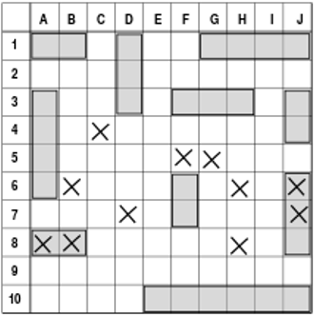
Propositions – Ships *Note: The Way of expressing Position, orientation, and size are subject to change
5 Ships are defined as s1, s2, s3, s4, s5, which are the ships Carrier, Battleship, Cruiser, Submarine and Destroyer, respectively.
They propositions reside in the ship's properties: size, position, and orientation.
There are four sizes: 5, 4, 3, and 2 spaces (Carrier = 5, Battleship = 4, Cruiser/Submarine = 3, Destroyer = 2). They are defined as size5, size4, size3, size2. These propositions are true obviously depending on the actual size of the ship it is defining. If a ship occupies 5 spaces, size5 would be true.
Position is a grid of (x, y) coordinates, each being a proposition that evaluates the most top left location of the ship. It is true if and only if the ship's top left corner resides on that location. The indexes of the grid start at 1.
Orientation is a proposition and is true if the ship is horizontal and false if the ship is placed vertically.
In the example above, looking at the top left ship, an s5 destroyer ship, the following propositions would be true (and everything else would be false):
s5.size2 (as it takes up 2 spaces)
s5.position[(1, 1)] (as the top left of the ship resides on (1, 1))
s5.orientation (as it is in a horizontal position)

Slide 4
Propositions – Grid *Note: The Way of expressing ship positions are subject to change
The board, player_board, has two properties: the positions of the ships, and the positions of where the opponent has hit (which we have defined as ship_position and hit_position respectively). Therefore each square has two propositions.
Again, for the boards, the indexes of the grid start at 1, no matter if referring to the horizontal or vertical axis.
The first proposition, being whether a ship resides on the square, evaluates to true if there is a ship part on that square, regardless of which part of which ship it is and regardless of which direction that ship is facing.
The second proposition, will evaluate to true if the opponent has previously declared a hit to that square. This proposition does not care if there is a ship on that square or not, it will always evaluate to true if there is a hit (an X) on that square and false otherwise.
In the example above,
For the property, ship_board([x, y]) those in red will evaluate to true:
(e.g.) player_board.ship_board([4, 3])
For the property, hit_board([x, y]) those in blue will evaluate to true:
(e.g.) player_board.hit_board([10, 7])

Slide 5
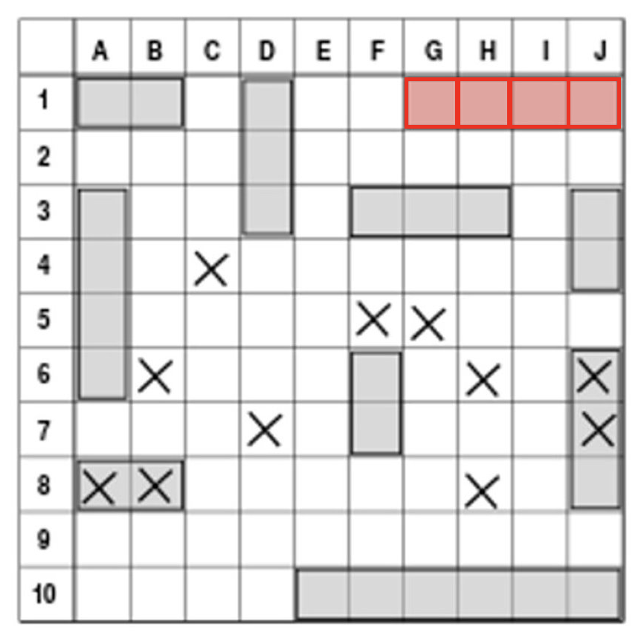
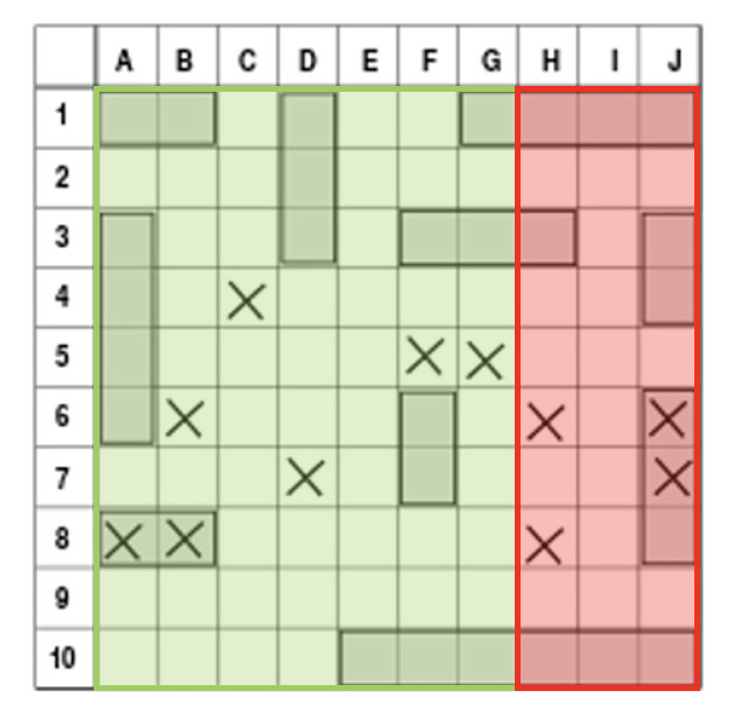
Constraints
*Note: LOOKING FOR A NICER WAY TO EXPRESS CONSTRAINTS
The orientation and position of the ships are randomly generated and placed onto the board, but the ships must adhere to certain constraints to have a valid placement.
The size of a ship refers to the number of squares it occupies, and for each ship, there are different restrictions as to which position it may take. Remember, the position of a ship is true if its top left corner resides on that location.
The position of a horizontal ship has its coordinates restricted such that the maximum x-coordinate it can hold is equal to board size - (ship length – 1). A similar constraint is used for vertical ships which have the maximum y-coordinate as board size - (ship length – 1). This ensures that the ships stay within the board.
In the example above:
For the battleship highlighted in red:
s2.size4 (as it takes up 4 spaces)
s2.position[(7, 1)] (as the top left of the ship resides on (7, 1), and 7 is the max x-coordinate it may occupy: 10 - (4 - 1) = 7)
s2.orientation (as it is in a horizontal position)
In the example above:
If we wanted to add a horizontal battleship (size4) to the board, the constraints allow it to be placed anywhere that is highlighted green, but not where it is red:
where Pi,j: i is row number, j is column number
¬P_{1,8} ∧ ¬P_{1,9} ∧ ¬P_{1,10} ∧ ¬P_{2,8} ∧ ¬P_{2,9} ∧ ¬P_{2,10} ∧ ¬P_{3,8} ∧ ¬P_{3,9} ∧ ¬P_{3,10} ∧ ¬P_{4,8} ∧ ¬P_{4,9} ∧ ¬P_{4,10} ∧ ¬P_{5,8} ∧ ¬P_{5,9} ∧ ¬P_{5,10} ∧ ¬P_{6,8} ∧ ¬P_{6,9} ∧ ¬P_{6,10} ∧ ¬P_{7,8} ∧ ¬P_{7,9} ∧ ¬P_{7,10} ∧ ¬P_{8,8} ∧ ¬P_{8,9} ∧ ¬P_{8,10} ∧ ¬P_{9,8} ∧ ¬P_{9,9} ∧ ¬P_{9,10} ∧ ¬P_{10,8} ∧ ¬P_{10,9} ∧ ¬P_{10,10}

Slide 6
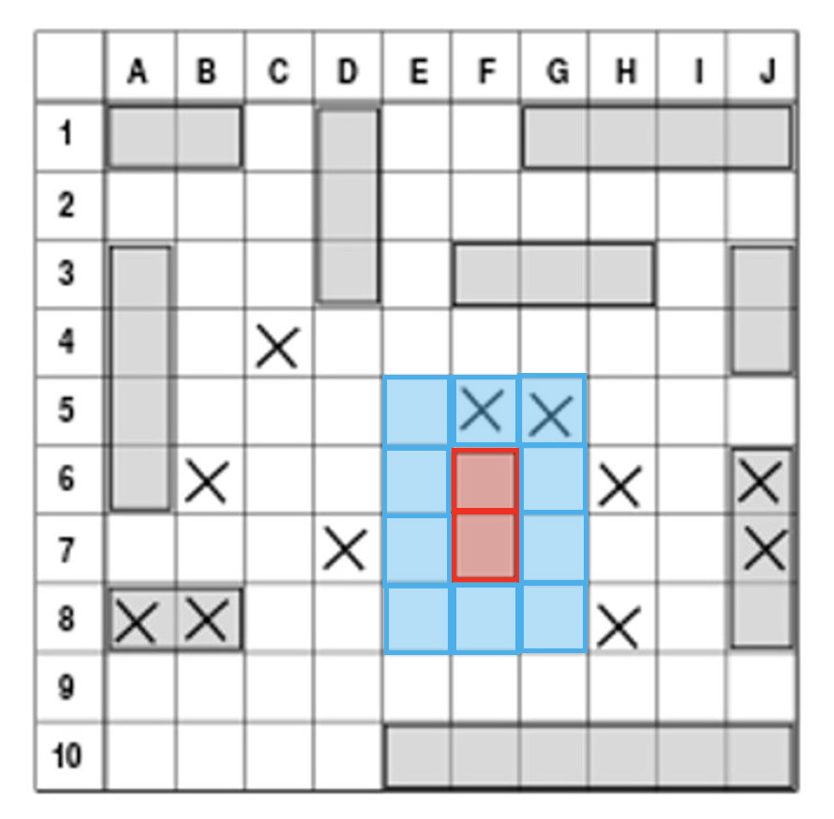
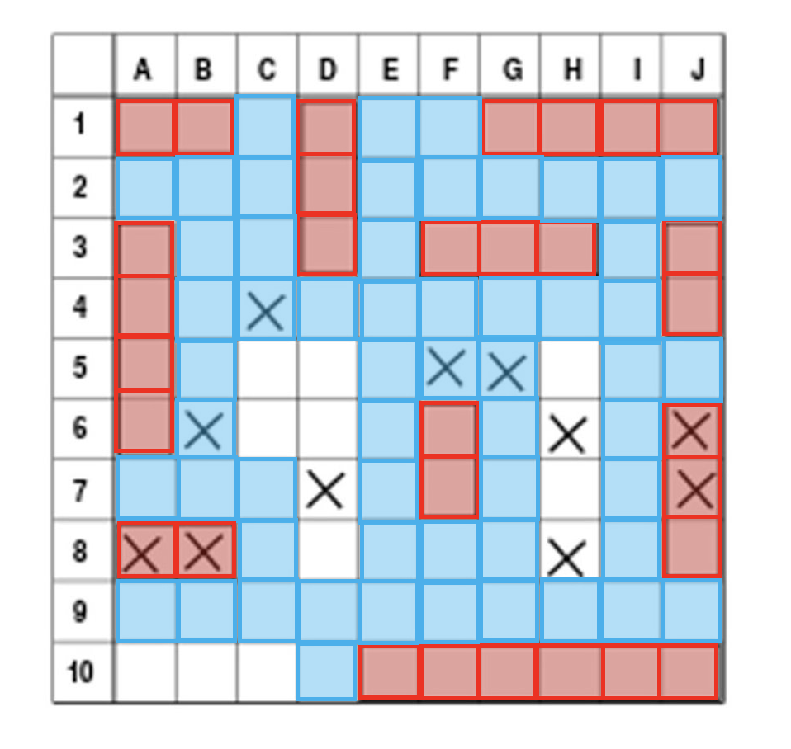
Constraints
*Note: LOOKING FOR A NICER WAY TO EXPRESS CONSTRAINTS
The ships must also be placed such that there are no neighboring ships in any of the immediately surrounding spaces and they cannot overlap one another.
If a vertical ship is placed at (i, j) on the board, then the spaces (i-1, j-1) to (i-1, j+(size+1)), (i, j-1), (i, j+size) and (i+1, j+1) to (i+1, j+(size+1)) must be false since no ship can occupy those spaces.
We have something similar for horizontal ships, where if a ship is placed at (i, j) on the board, then the spaces (i-1, j-1) to (i+(size+1), j-1), (i-1, j), (i+size, j) and (i-1, j+1) to (i+(size+1), j+1) must be false.
In the example above:
For the destroyer ship highlighted in red:
s5.size2, s5.position[(6, 6)], s5.orientation is false
The areas surrounding the ship (highlighted in blue) are restricted such that no other ship may occupy the space.
In the example above:
The restricted spaces surrounding the ships have been highlighted in blue. If we want to add a new destroyer ship (size2) to the board, the constraints allow for the positions:
where Pi,j: i is row number, j is column number
P_{5,3} ∨ P_{5,4} ∨ P_{5,8} ∨ P_{6,3} ∨ P_{6,4} ∨ P_{6,8} ∨ P_{7,4} ∨ P_{7,8} ∨ P_{10,1} ∨ P_{10,2}

Slide 7
Model Exploration
List all the ways that you have explored your model. - counting number hits, possible ship placements
Include not only the final version, but intermediate versions as well.

Slide 8
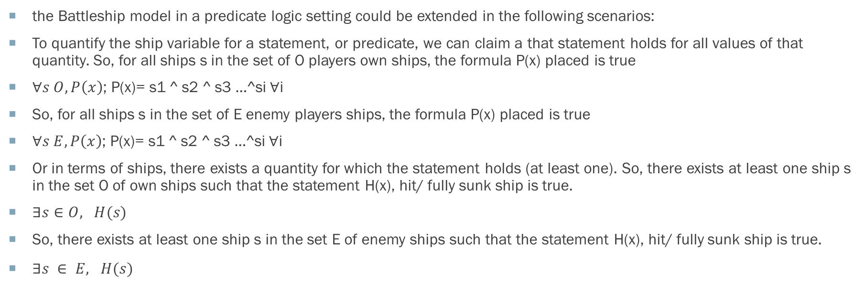
First-Order Extension
the Battleship model in a predicate logic setting could be extended in the following scenarios:
To quantify the ship variable for a statement, or predicate, we can claim a that statement holds for all values of that quantity. So, for all ships s in the set of O players own ships, the formula P(x) placed is true
$∀s O, P\left(x\right)$; P(x)= s1 ^ s2 ^ s3 …^si $∀$i
So, for all ships s in the set of E enemy players ships, the formula P(x) placed is true
$∀s E, P\left(x\right)$; P(x)= s1 ^ s2 ^ s3 …^si $∀$i
Or in terms of ships, there exists a quantity for which the statement holds (at least one). So, there exists at least one ship s in the set O of own ships such that the statement H(x), hit/ fully sunk ship is true.
$∃s∈O, H(s)$
So, there exists at least one ship s in the set E of enemy ships such that the statement H(x), hit/ fully sunk ship is true.
$∃s ∈ E, H(s)$

Slide 9
Jape
Carrier (S1)
S1 ∧ P1 ∧ P2 ∧ P3 ∧ P4 ∧ P5 ⊢ ¬P6
With this proof we want to be able to show that S1 (carrier ship of size 5) is true (correctly placed on the map) and that the spaces it occupies are also true and satisfy the constraints.
P1-P5 are the spaces the carrier occupies, and P6 is not true for S1.
P1 P2 P3 P4 P5 P6
Battleship (S2)
S2 ∧ P1 ∧ P2 ∧ P3 ∧ P4 ⊢ ¬P5
P1-P4 are the spaces the battleship occupies, and P5 is not true for S2.
P1 P2 P3 P4 P5
Submarine (S4)
Cruiser (S3)
S3 ∧ P1 ∧ P2 ∧ P3 ⊢ ¬P4
S4 ∧ P1 ∧ P2 ∧ P3 ⊢ ¬P4
P1-P3 are the spaces the cruiser or submarine occupies, and P4 is not true for S3 or S4.
P1
P2
P3
P4
P1
P2
P3
P4
S5 ∧ P1 ∧ P2 ⊢ ¬P3
P1-P2 are the spaces the destroyer occupies, and P3 is not true for S5.
Destroyer (S5)
P1 P2 P3

Slide 10
Useful Notation
Feel free to copy/paste the symbols here and remove this slide before submitting.
∧ ∨ ¬ → ∀ ∃

Slide 11
Feedback questions
1. Opinion on Var usage for propositions, given the commented and uncommented drafts
2. Thoughts on constraints and complexity – possible to loop through constraints?
3. In terms of quantifiers, is the extensions clear?

Slide 12
End

